Slide 1
Lesson 3.15
Managing Information
CGPRT(W) : Ensuring Clean Seas and Coasts in Western Region ……

Slide 2
Objective
To understand the need for a communications plan to gather and disseminate information during an incident.
CGPRT(W) : Ensuring Clean Seas and Coasts in Western Region ……

Slide 3
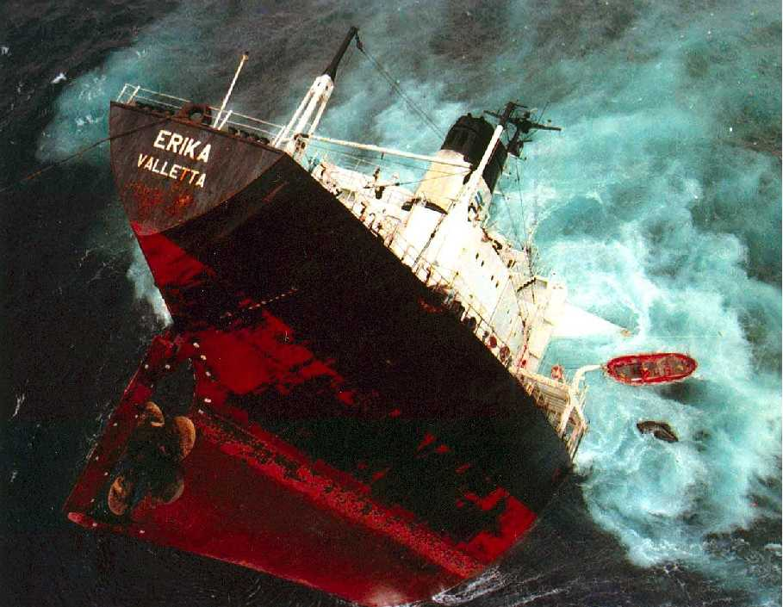
Strong visuals….
CGPRT(W) : Ensuring Clean Seas and Coasts in Western Region ……

Slide 4
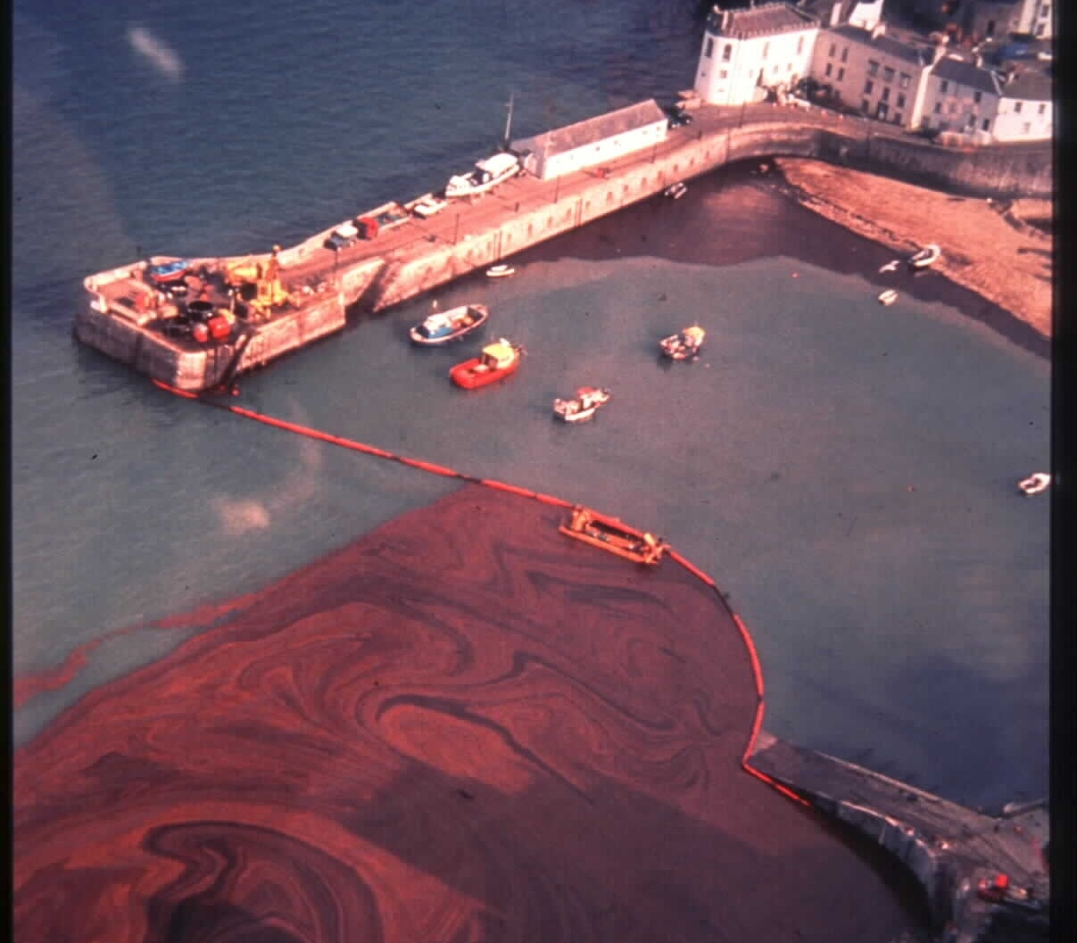
CGPRT(W) : Ensuring Clean Seas and Coasts in Western Region ……

Slide 5
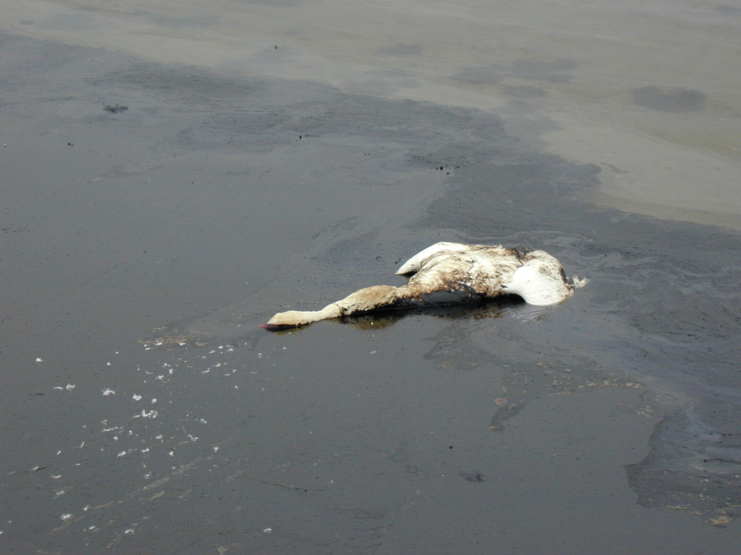
CGPRT(W) : Ensuring Clean Seas and Coasts in Western Region ……
Source: Greenpeace

Slide 6
Typical Challenges
Issues common to many incidents:
Flexibility of scale
Response organization
Internal communication
Management of volunteers
Health and safety
Media and public relations
CGPRT(W) : Ensuring Clean Seas and Coasts in Western Region ……

Slide 7
Effective Response
An effective response does not necessarily depend on large amounts of specialist equipment.
However it does depend on:
organizational infrastructure
  clearly defined and understood
leadership
  well managed resources
information management
CGPRT(W) : Ensuring Clean Seas and Coasts in Western Region ……

Slide 8
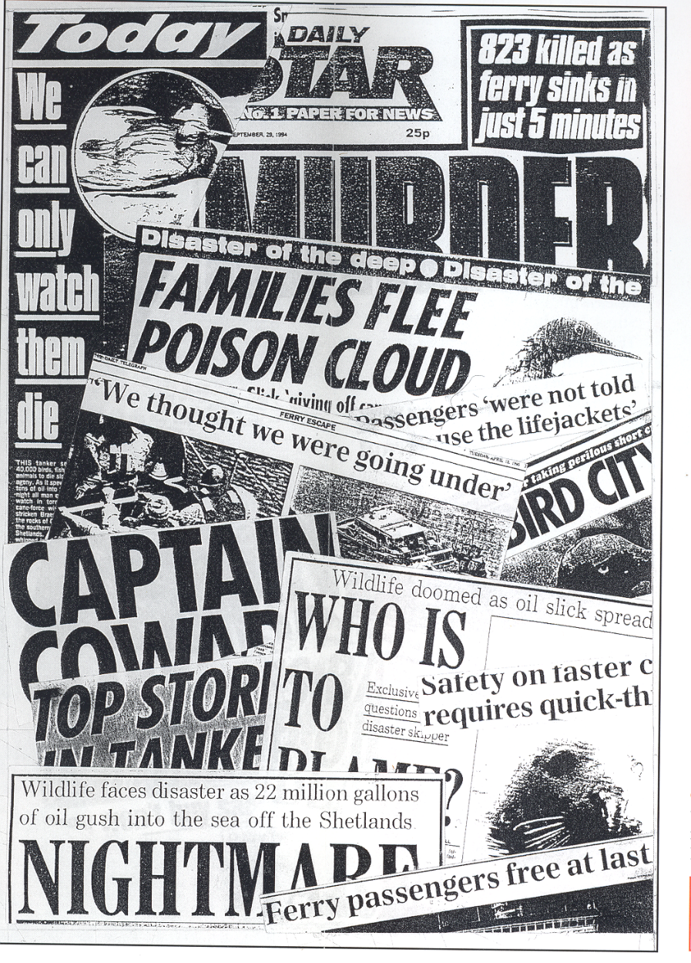
Crisis − Perception vs. Reality
Often, the real crisis is not in what actually
has happened, but what people and the media believe has happened.
CGPRT(W) : Ensuring Clean Seas and Coasts in Western Region ……

Slide 9
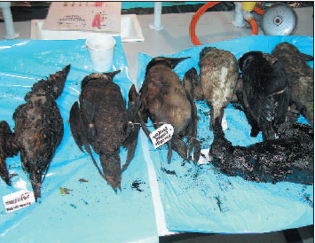
Challenges
Emergencies/
Crisis
Emotional stories
Highly visible
Public concerns
CGPRT(W) : Ensuring Clean Seas and Coasts in Western Region ……

Slide 10
Challenges
Oil spills generate bad publicity
  Governments and industry
Negative impressions can be redressed with good media communications
Senior managers and administrators have a responsibility to plan
CGPRT(W) : Ensuring Clean Seas and Coasts in Western Region ……

Slide 11
Information
Information can be used to:
warn people threatened by immediate danger
advise the community on how to act properly to avoid danger/hazard
informing on the response operation
create a solid foundation for people’s faith in the response
This requires a Communications Plan
CGPRT(W) : Ensuring Clean Seas and Coasts in Western Region ……

Slide 12
Information
Information must be:
open and accurate
given swiftly and continuously
simple and easily accessible
clear and concise
CGPRT(W) : Ensuring Clean Seas and Coasts in Western Region ……

Slide 13
Media Challenges
Inequality of an emergency event
  Circumstances do not favour the authority dealing with the event
  It is a golden opportunity for the media
  Media can talk in approximate terms
  Technical/scientific information may not have an impact on public opinion
  Credibility of media can be higher than that of the responsibility authority
CGPRT(W) : Ensuring Clean Seas and Coasts in Western Region ……

Slide 14
Communcation challenges
Credibility
Clear messages
Having the correct information and releasing it at the right time
Getting the attention
Seeing the crisis from the perspective of the recipient
CGPRT(W) : Ensuring Clean Seas and Coasts in Western Region ……

Slide 15
Communication Challenges
The public has a right to know
Media is the channel to the general public
Bad news travels fast
Under-siege mentality
Media plan not to be improvised
If the media is poorly managed, the impression given is that the operation is badly managed
Plan, exercise, learn lessons, update plan
CGPRT(W) : Ensuring Clean Seas and Coasts in Western Region ……

Slide 16
Effective Response
The management of information is critical.
Information movement can be considered in two dimensions:
Vertical (internal)
  the flow of information up and down the command structure of the incident
Horizontal (external)
  The flow of information out to media and public
  The reaction/feedback from the media and public
CGPRT(W) : Ensuring Clean Seas and Coasts in Western Region ……

Slide 17
Two plans
Communications plan
  Response team
  Response community
  Senior administrators/Ministers
  Regional and international contacts
Media relations plan
Media
Public
CGPRT(W) : Ensuring Clean Seas and Coasts in Western Region ……

Slide 18
Communication Planning
Five-step approach to communication planning
Audience identification
Objective setting
Information/message development
Choice of appropriate communication channel(s)
Monitoring/evaluation/review
Avoid an over-reliance on the mass media
Consider the impact of social media
CGPRT(W) : Ensuring Clean Seas and Coasts in Western Region ……

Slide 19
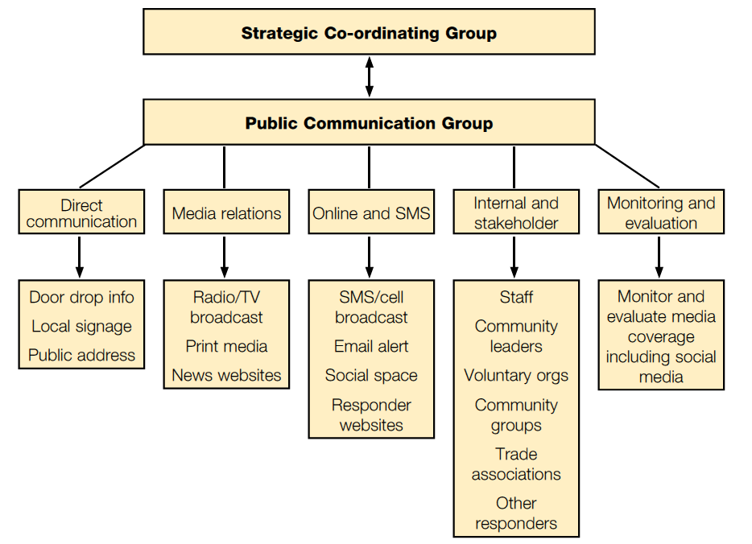
CGPRT(W) : Ensuring Clean Seas and Coasts in Western Region ……

Slide 20
Summary
In this lesson we have considered the need for a communications plan to gather and disseminate information during an incident.
We have also considered how best to address communications planning.
CGPRT(W) : Ensuring Clean Seas and Coasts in Western Region ……

Slide 21
Any questions?
CGPRT(W) : Ensuring Clean Seas and Coasts in Western Region ……

